Slide 1
Efficient time series processing for edge computing and IoT

Slide 2

Efficient time series processing for edge computing and IoT
Oresztesz Margaritisz
Chief Engineer, <EPAM>
Event organized by: Academic Partners Foundation

Slide 3
Why edge computing?

Slide 4
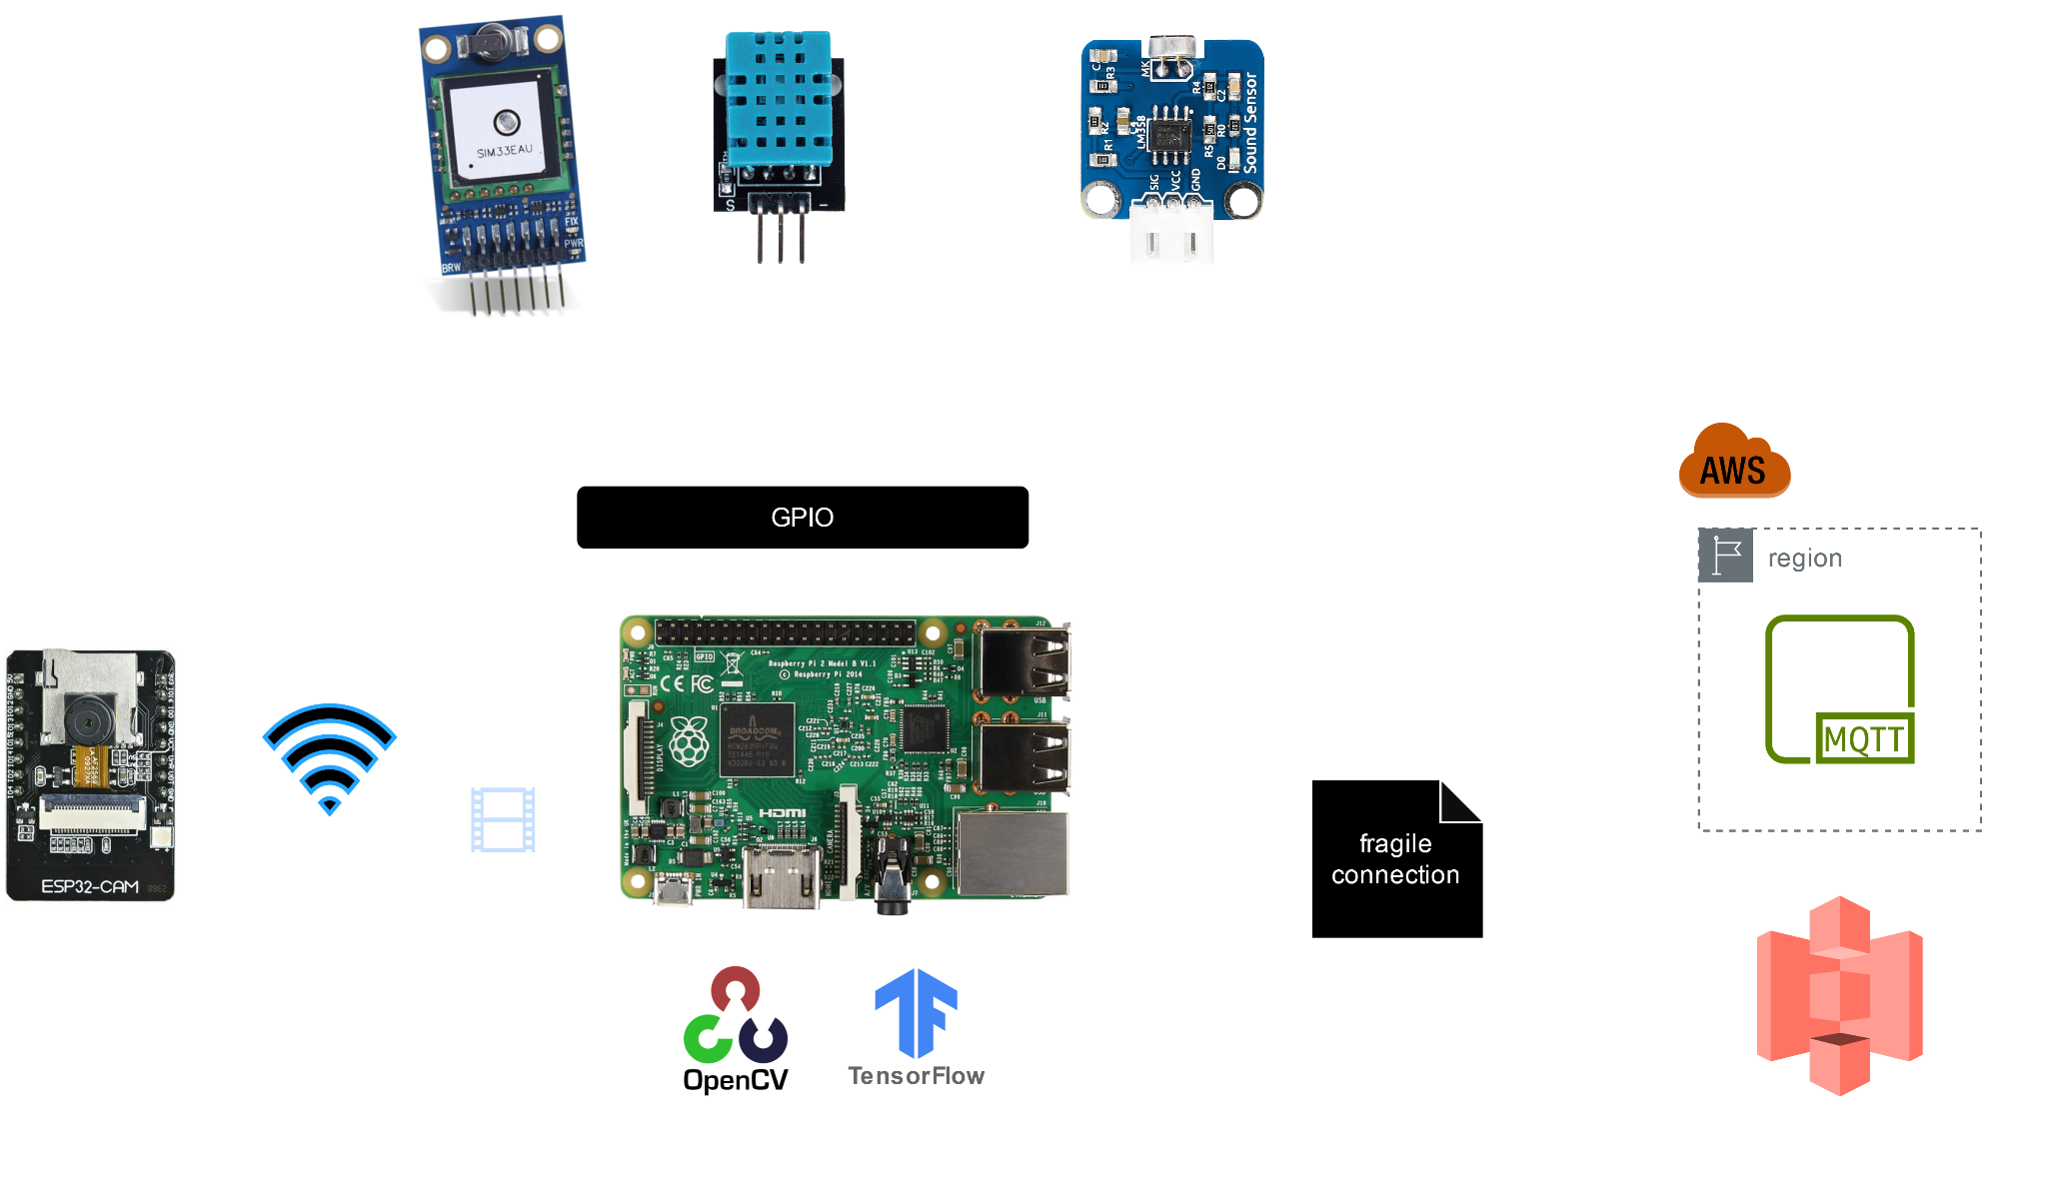
10,000 feet view

Slide 5
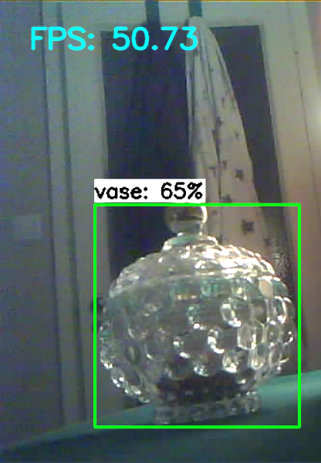
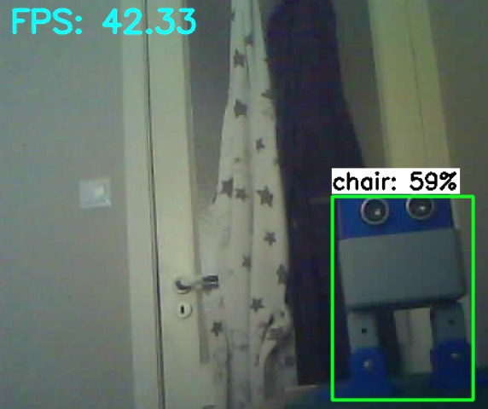
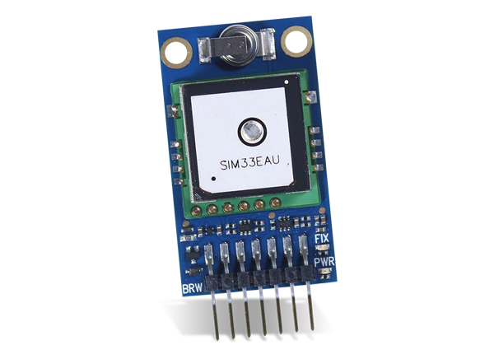
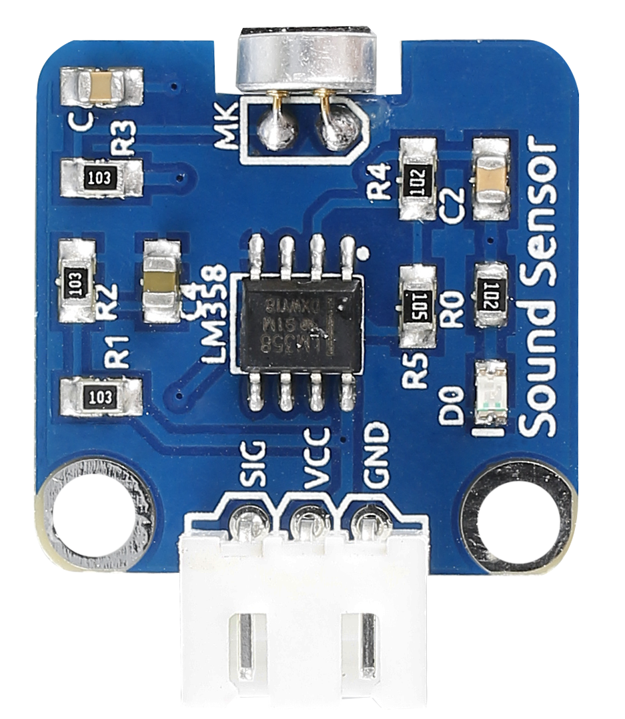
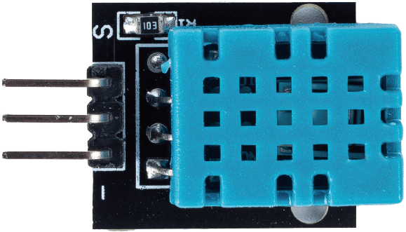
VS
{
"timestamp": 1725888108,
"probability": 0.59,
"box": [642, 1011, 320, 480],
"label": "robot"
}
50-100Hz

Slide 6
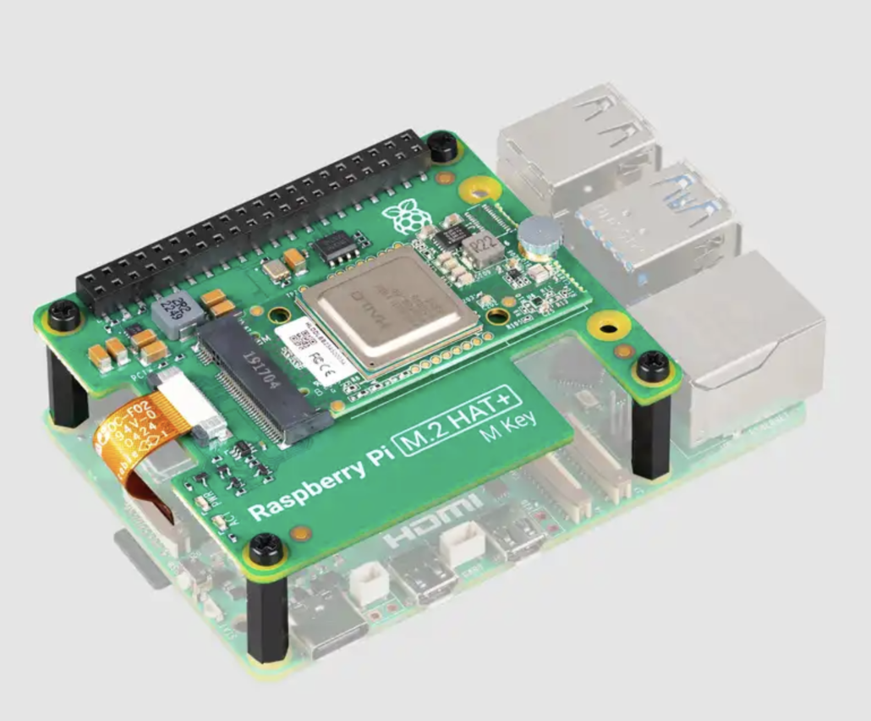
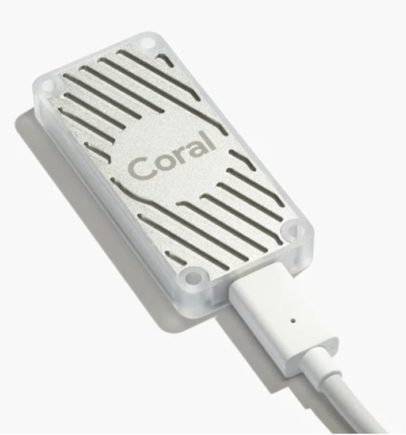
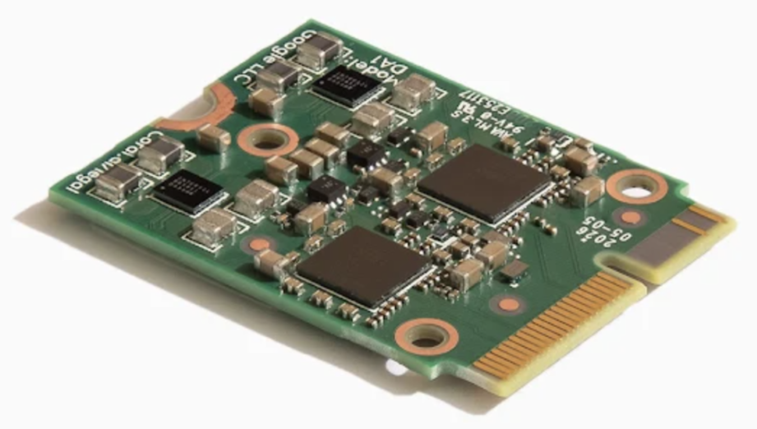
Hailo AI Kit
Coral Edge TPU
AI Chipsets
Coral Dual Edge TPU

Slide 7
Internal Communication

Slide 8
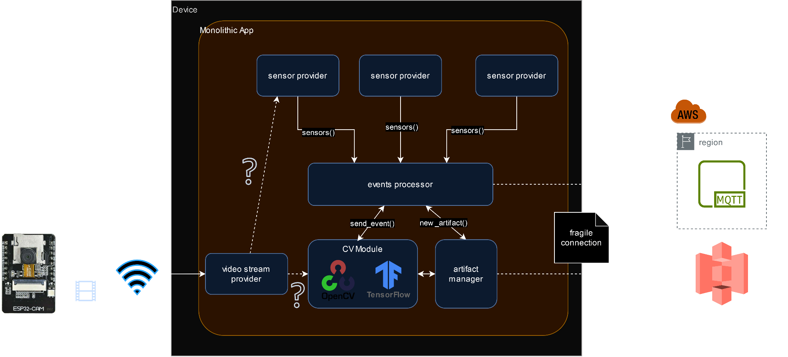
Internal Communication

Slide 9
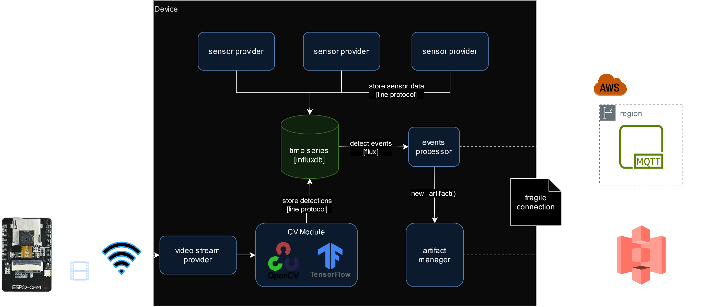
Time Series - Distributed

Slide 10
What are our constraints?

Slide 11
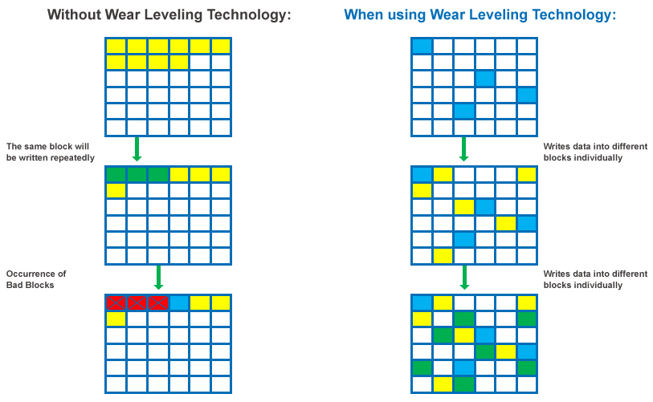
Wear Leveling

Slide 12
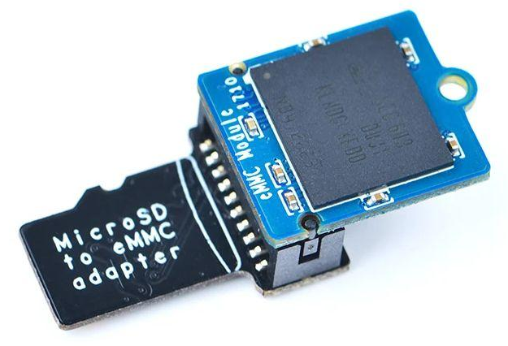

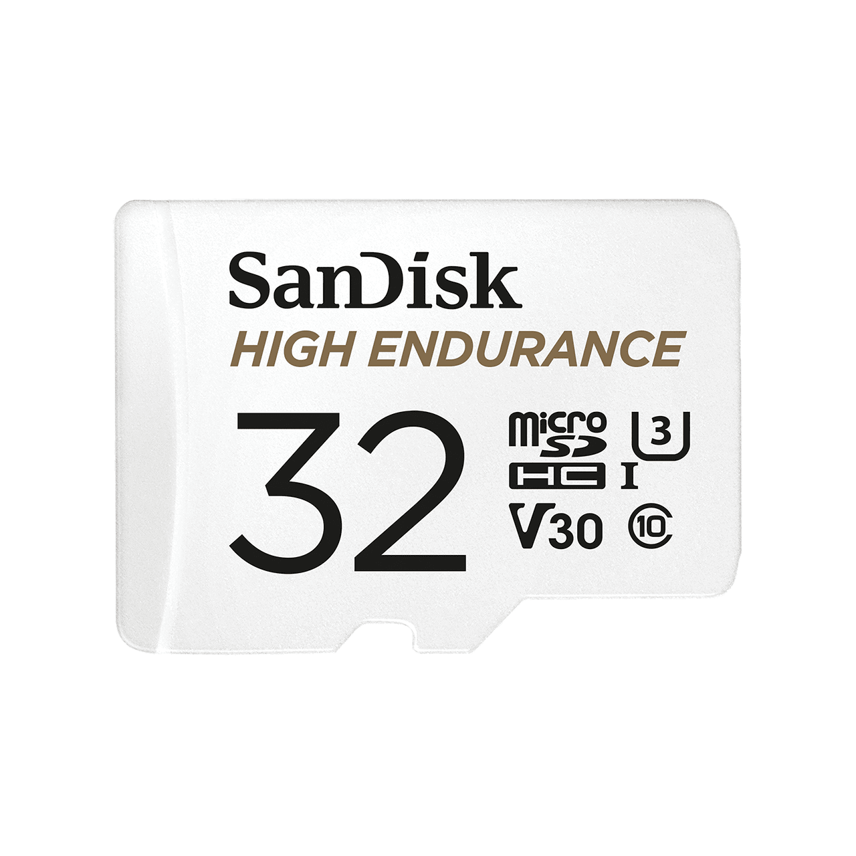
eMMC adapter
Wear Leveling - Hardware

Slide 13
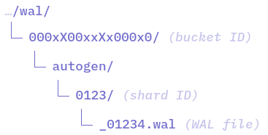
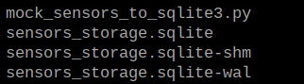
SQLite3 vs InfluxDB

Slide 14
Target Hardware
Hardware | Chipset | Instruction Set | SQLite3 | InfluxDB
Pi 2 Model B v1.1 | ARMv7 | 32 Bit
Pi 2 Model B v1.2 … Pi 5 Model B | ARMv8 | 64 Bit

Slide 15
Features We Want
Derived data - combinations
Resampling, downsampling
Aggregation
Background processing
Retention policies

Slide 16
Quality Attributes
Conceptual Integrity | reads & writes logically separated query & command encapsulation decoupling “sensing” from “recording” single responsibility principle

Slide 17
Quality Attributes
Maintainability, Reusability, Portability, Testability | installation schema checks lock-step deployments library support mock data format & injection feature coverage Integration options

Slide 18
Quality Attributes
Performance | latency (soft real-time) throughput (datapoints/sec) memory footprint CPU usage IOPS

Slide 19
Quality Attributes
Security | remote/local port exposed read/write permissions separated data available for certain Unix users data protected with strong password

Slide 20

Drunk Crane Operator

Slide 21
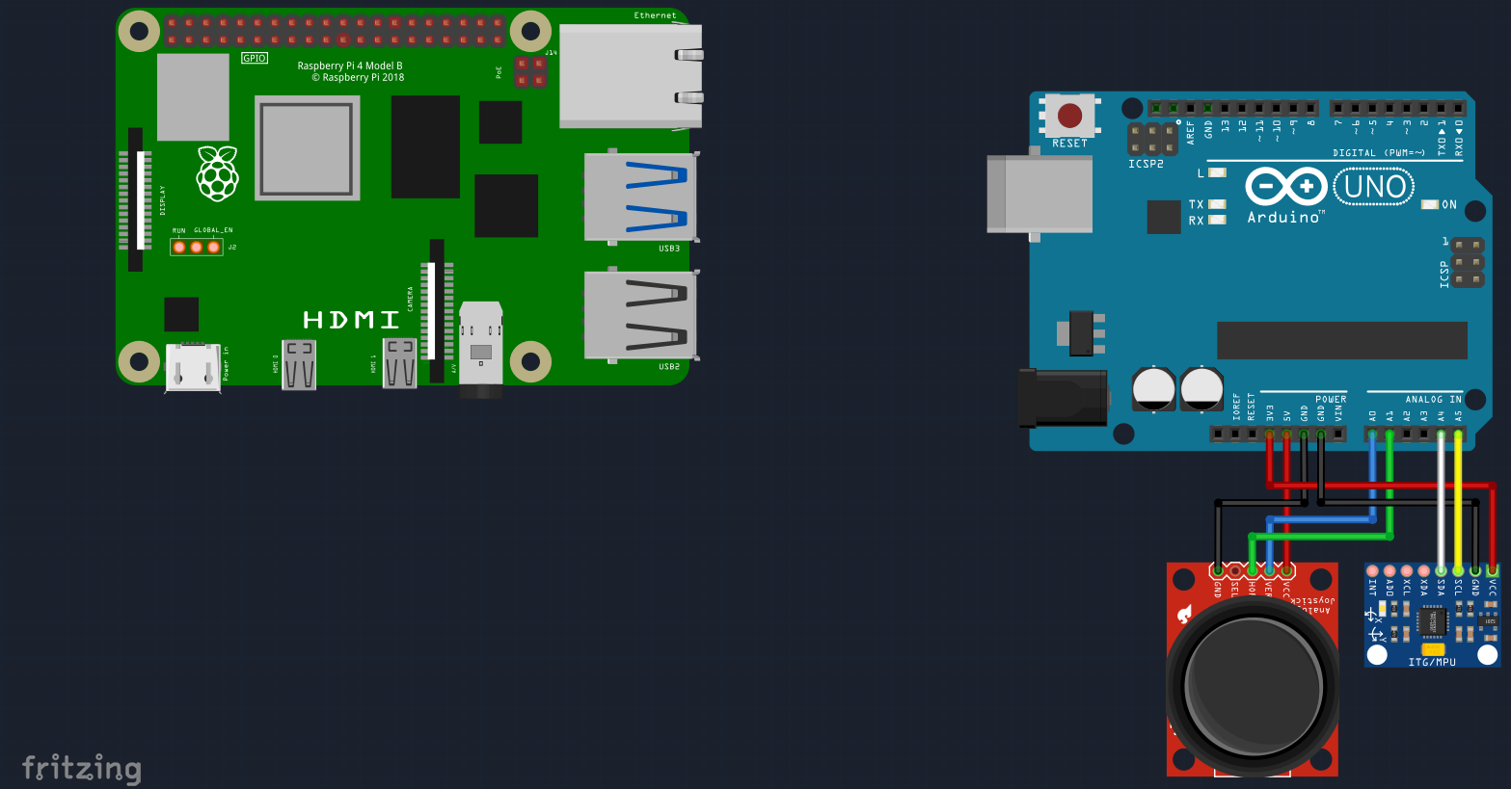
Wiring
SERIAL

Slide 22
Core Features

Slide 23
Performance

Slide 24
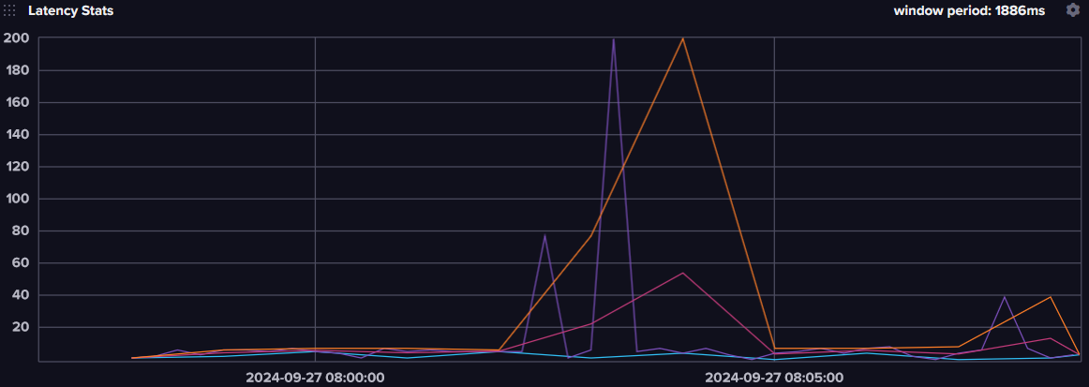
Latency

Slide 25
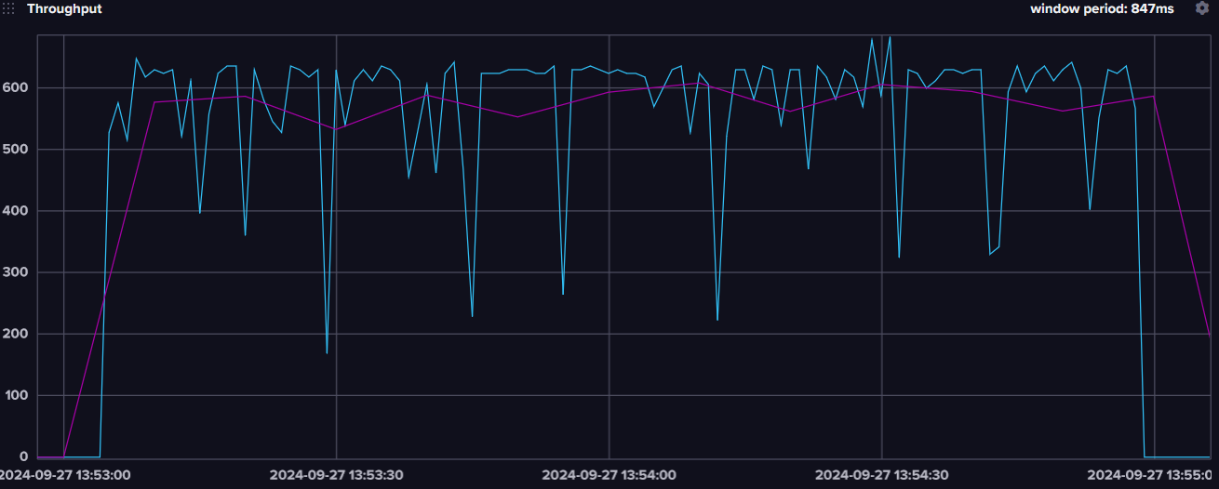
Throughput - SYNC

Slide 26
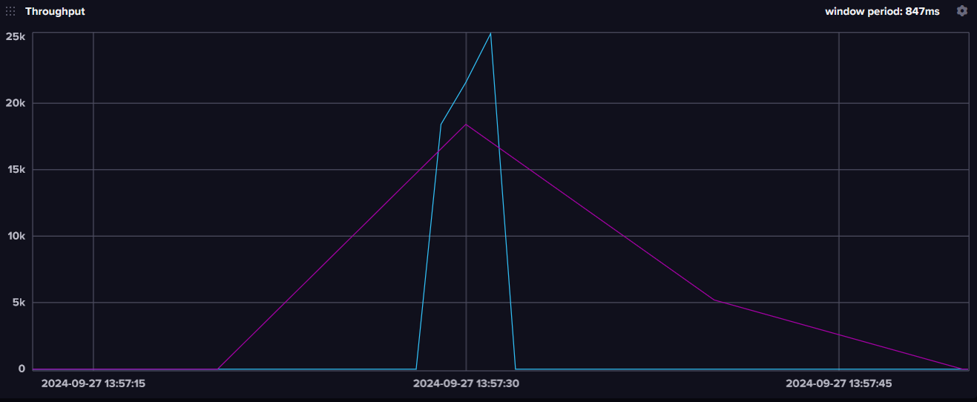
Throughput - ASYNC

Slide 27
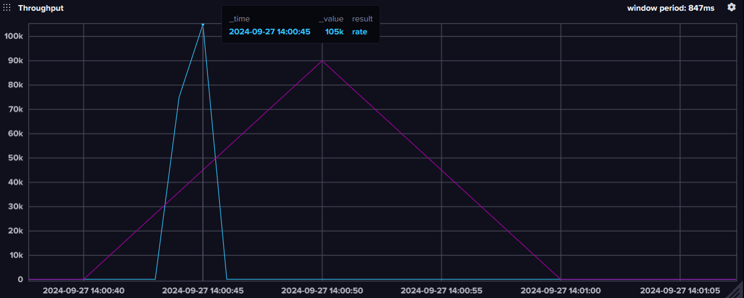
Throughput - Batch

Slide 28
Memory Consumption

Slide 29
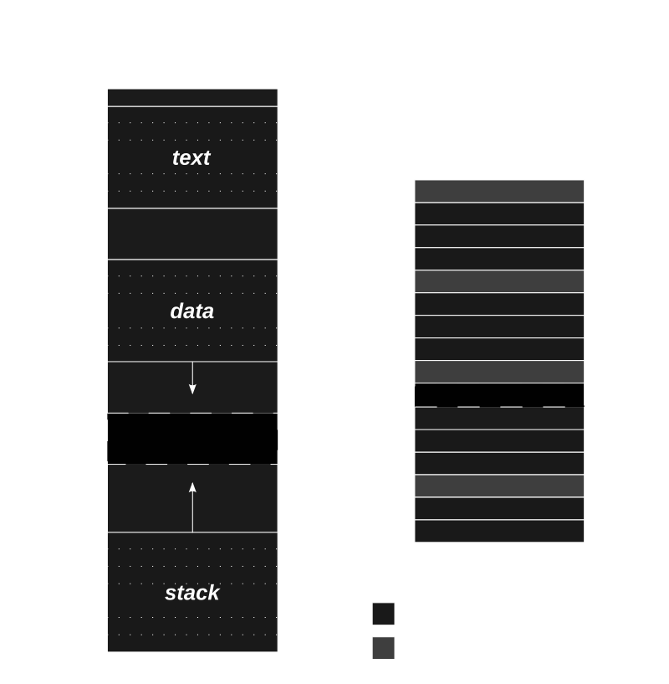
Notes:
executable segment contains separate text and data segments.

Slide 30
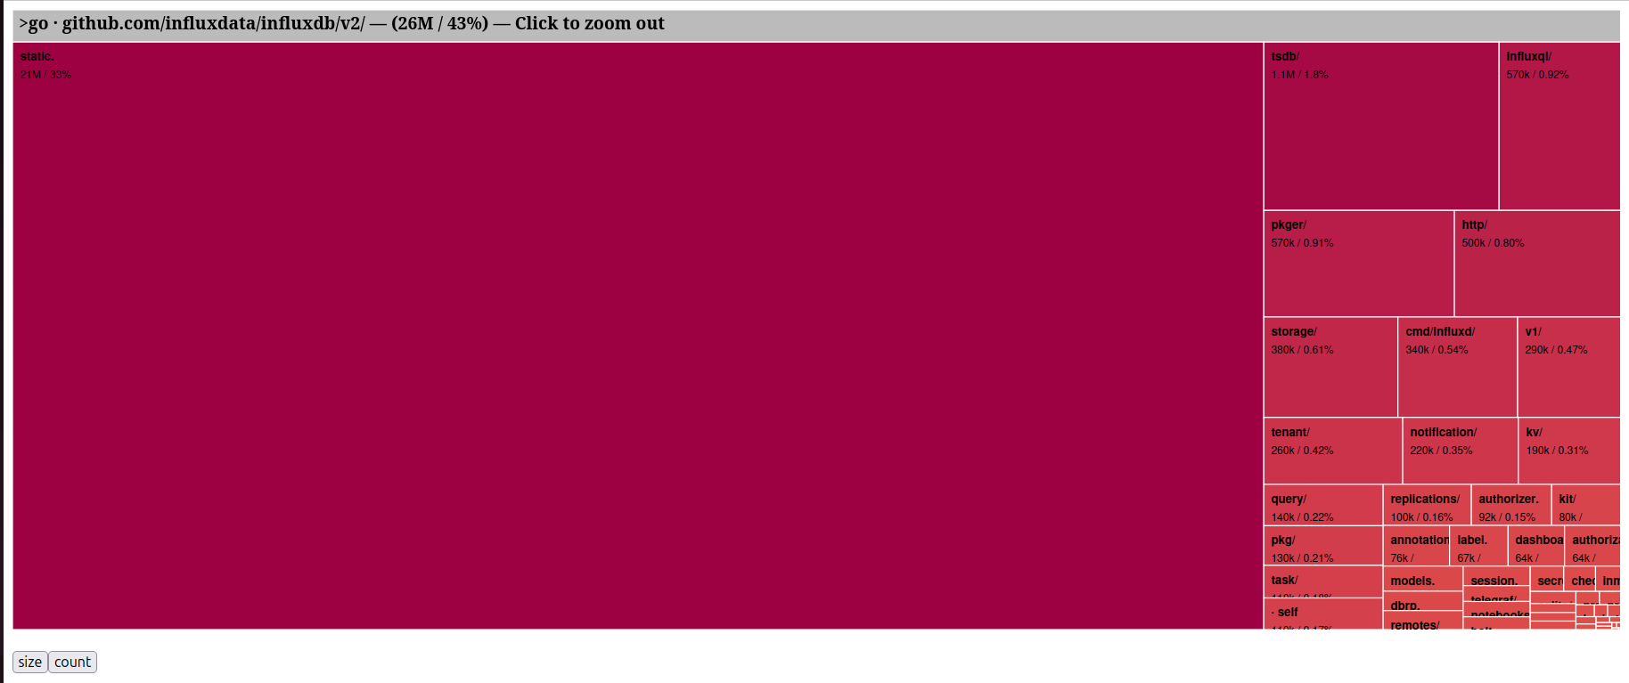
Binary Size

Slide 31
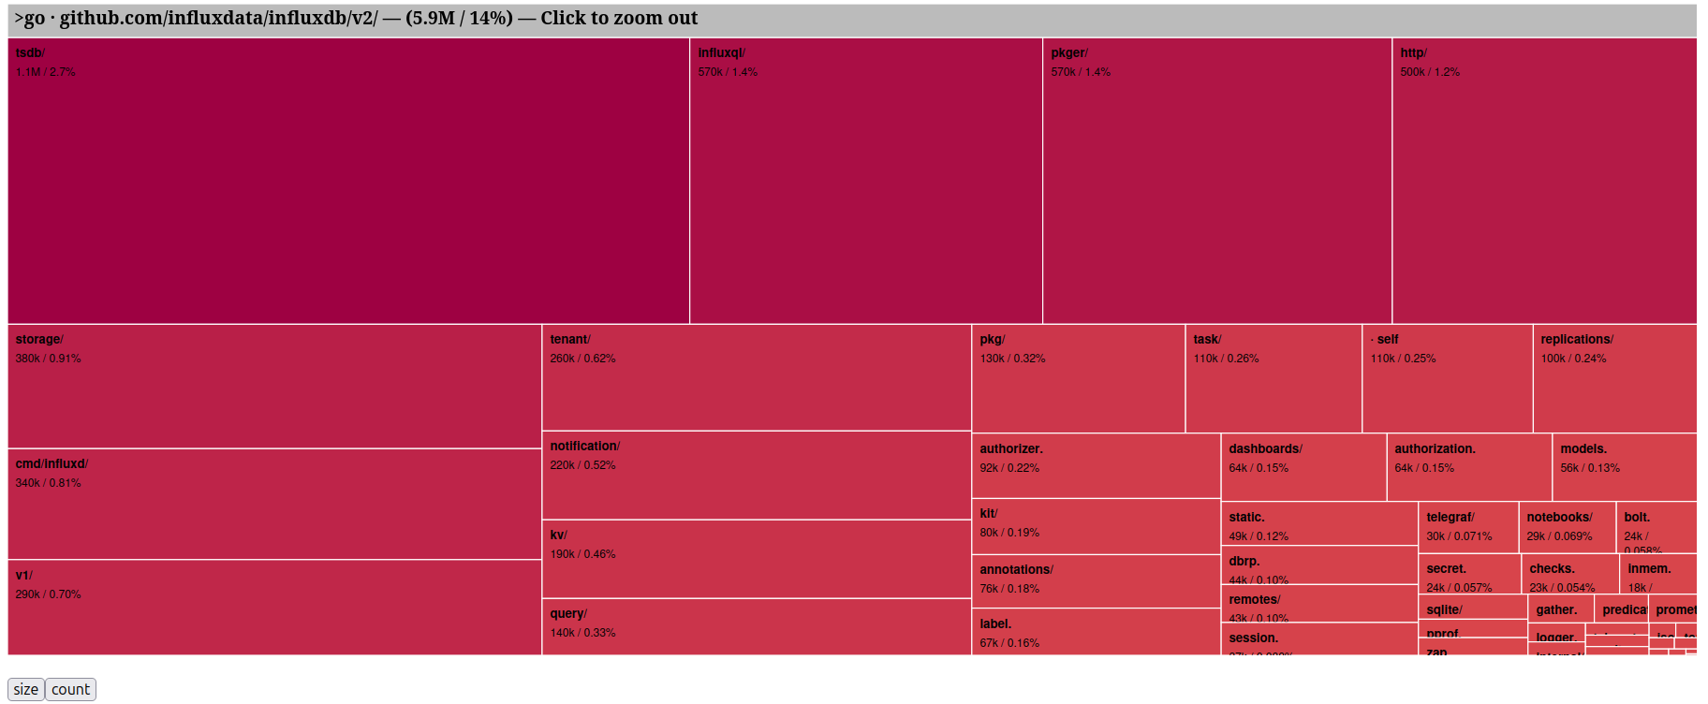
Binary Size - Reduced

Slide 32

Hints

Slide 33
Questions?

Slide 34

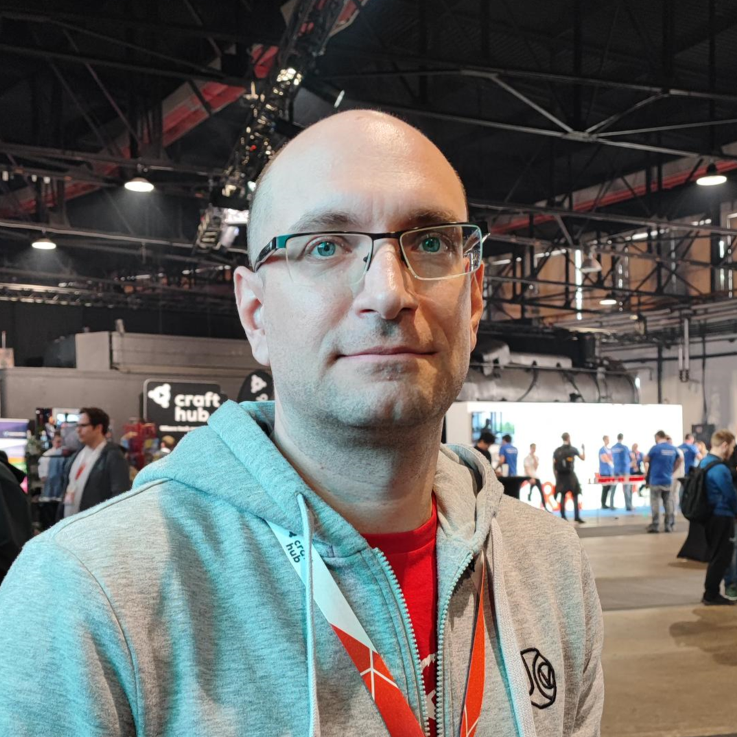
Thanks!

